Slide 1
INTERVIEW ATTENDANCE
YICHUN LIU,
RUIFAN LIU,
RUOCHEN WANG,
YUAN SHI
Notes:
In this project, we analyzed data about the recruitment industry in India from 2014 to 2016.
We first did dimension reduction using random forest, and then used the logistic regression to fit the response variable “observed attendance” over the predictors.
We also fit the LDA and QDA model on the data but then abandoned them because we realized that our data doesn’t satisfy the multivariate normal distribution assumption since all variables are categorical.
Additionally, we also fit LASSO and ridge models, but they didn’t perform as well as the logistic regression. This result matches with our expectation, because logistic performs better on our binary response variable.
Therefore, we chose to fit the logistic regression model on our data.

Slide 2
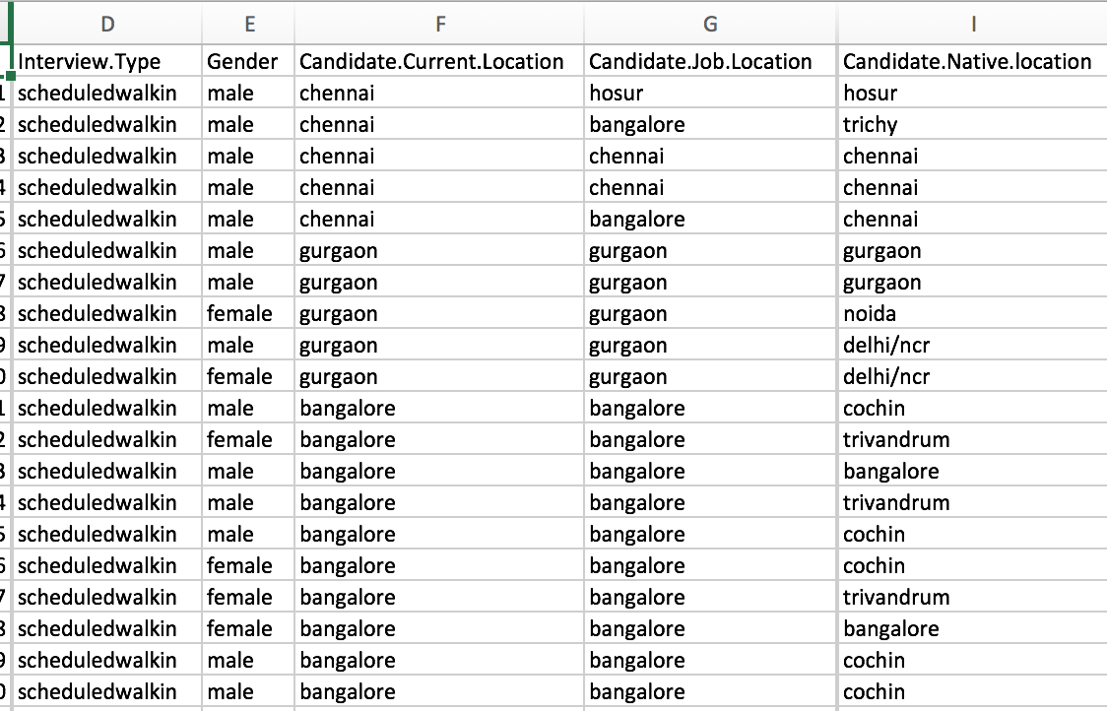

DATA
Categorical…
Notes:
Here is a preview of our data.
At the first glance, all of them are categorical! This added a little bit challenge when we were trying to choose the models to do the prediction.
Let’s take a closer look!
We have 17 predictors in total, and we divided them into 2 groups according to the nature of the variables.
The first group contains the basic information about the candidates and the interview, such as the candidate’s gender and location, and the type and location of the interview.

Slide 3
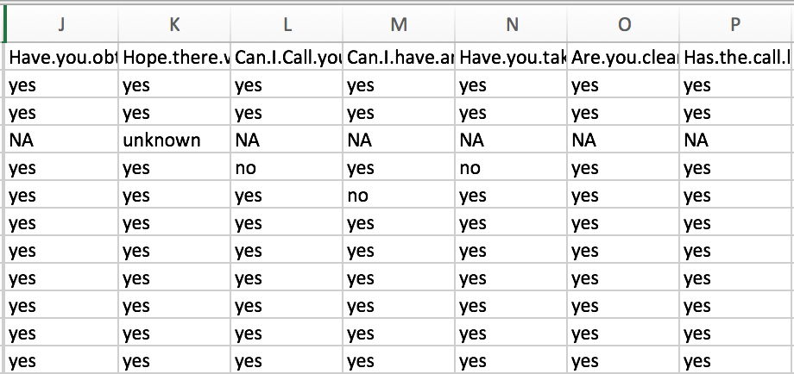
DATA
Split it!
Notes:
The second group contains 7 questions that are asked by a recruiter while scheduling the candidate. For example, “Have.you.obtained.the.necessary.permission.to.start.at.the.required.time”, or “Can.I.Call.you.three.hours.before.the.interview.and.follow.up.on.your.attendance.for.the.interview”.
We did 2 things to clean our data.
In our original data, we found that there are both capital letters and lower-case letters in the candidate’s response. For example, R identifies “Yes” with a capital Y and “yes” with a lower-case y as two different levels, which does not make sense, so we had change all the responses into consistent lower-case letters.
Also, when we took a look at the data, we found that there are around 20% missing data among the one thousand and two hundred observations we have. Since our data are all about choices made by individuals, it is hard to predict the trend and fill out the data, so we eliminated these missing values.

Slide 4
GOALS
1
2
Predict whether a candidate will attend the interview based on the predictors
Decide which part of the variables have more impact on interview attendance (questions or non-questions)
Notes:
We have 2 goals in this project.
The first is to predict whether a candidate will attend the interview based on the informations we have. This part is supervised.
Then, we try to decide which part of the variables have more impact on interview attendance (questions or non-questions). This part is unsupervised.
These are also the questions we are trying to answer.
In this presentation, I will only go through the first question, since we are still working on the second part.

Slide 5
PRE-ELIMINATING MODELS
Linear regression model
LDA/QDA
only applicable to numerical predictors
KNN
fails on high dimensions
hard to pick a neighbor according to similarity
Notes:
Since our predictors and response are all categorical variables, we are predicting using classification rather than regression, our choice of models are very limited.
We cannot do linear regression on our data, since our response variable only have two levels: YES and NO, so we chose to do logistic regression instead.
LDA and QDA are also not applicable to our data, because they require our predictors to have numerical values.
We also didn’t use KNN, because it may fail on high dimensions, and it’s also hard to decide which neighbor is “near”.

Slide 6
PREPROCESSING
1
2
3
4
Use best model to show prediction accuracy
Dimension reduction for all variables, select significant variables, then use the selected variables to fit a model to see accuracy
Repeat step 2 for only the question variables
Repeat step 2 for the non-question variables
Notes:
Now we want to analyze the interview attendance, and how it is related to the information we collected from the interviewees.
Our process includes 4 parts:
1234
We did dimension reduction for 3 times because we wanted to examine which type of variables, questions or non-questions, had more impact on whether a candidate will attend the job interview.

Slide 7
OVERVIEW
train accuracy = 0.766
test accuracy = 0.67
Ridge:
train accuracy = 0.789
test accuracy = 0.67
Logistic:
Notes:
Before we did any dimension reduction, we first wanted to figure out which models would do a good job on the prediction.
We did Ridge and Logistic regression, and got the exactly same test accuracy.
The logistic regression had a slightly higher training accuracy.
By doing dimension reduction, we wanted to sacrifice some training accuracy so that we could improve the test accuracy.

Slide 8
DIMENSION REDUCTION & MODELS
Method | Training Accuracy | Test Accuracy
Group Lasso | 0.762 | 0.685
Random Forest | 0.736 | 0.692
Notes:
From class, we learned several ways to reduce the dimension of our data.
We first used the Lasso regression to find the most significant variables in predicting the interview attendance.
Then we encountered a problem- each of our predictor has several levels, and we were supposed to keep the variable in the model if any one of the levels is significant. We have nearly a hundred levels and we had to check each of them manually, which was an
enormous amount of work. To avoid this problem, we used group lasso instead.
Random Forest is another way to select significant variables.
We also considered the Adaboost method, but found that it was likely to overfit the data. So we picked Random Forest over adaboost.
Concluded method: We first reduced the dimension using random forest, and then fit the model using logistic regression.
And here are the training and test accuracies for the group lasso and random forest method.
From the table we can see that by doing dimension reduction using random forest, we got a higher test accuracy.

Slide 9
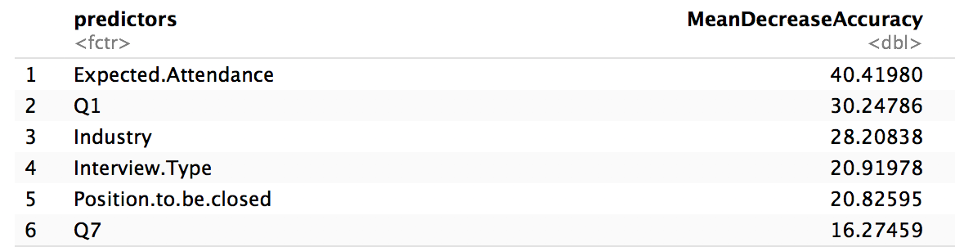
SIGNIFICANT VARIABLES
Q1: Have you obtained the necessary permission to start at the required time
Q7: Have the call letter been shared
Notes:
From Random Forest, we get 6 significant variables, which contains 2 questions predictors and 4 non-questions predictors.

Slide 10
RESULTS
Method | Training accuracy | Test accuracy
Ridge | 0.7662 | 0.670
Logistic | 0.789 | 0.670
Group Lasso | 0.762 | 0.685
Random Forest + Logistic | 0.736 | 0.692
Notes:
Both dimension reduction methods improved the performance of the model.
After dimension reduction, 6 variables were selected as our predictors. The test accuracy increased compared with full model prediction.

Slide 11
REFERENCE
https://www.kaggle.com/vishnusraghavan/the-interview-attendance-problem
Notes:
Presentation: 20%. Graded for good explanation of the questions and dataset (5%), correct explanations of methods used and why (5%), explanation and interpretation of results (5%) and quality of slides / presentation (clear informative figures, presenter explains things well and is engaged), (5%).

